Slide 1




SEO
Report

Slide 2

01.
About Company
02.
Initial Audit
03.
Keyword Research
04.
On-Page SEO Optimization Audit
05.
Technical SEO
06.
Content Strategy
07.
Off-Page SEO
08.
Conclusion

Slide 3


About Company
Adobe is a leading technology company that specializes in developing software for creativity and digital experiences
Their services include:
Creative Cloud
Design Software
Photography Software
Video & Audio Software
Document Cloud
Acrobat
Sign
Digital Marketing Services
Marketing Cloud
Analytics Cloud
Advertising Cloud
Commerce Cloud

Slide 4
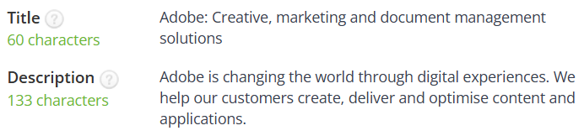
Initial Audit
Current Performance:
Website is well optimized and top Ranked for Search Engine
Title and Meta description are well describing the adobe service
Strengths:
Organic Visits are over 100K / month
Load time is 89 ms
User friendly design
Secure HTTPS connection
Keyword - Creative cloud (100K – 1M) monthly visits
Weakness:
Multiple SEO audit tools indicated an absence of H1 tags on the website
Images doesn’t have ALT and Title
Keyword Stuffing Creative Cloud -9 times

Slide 5
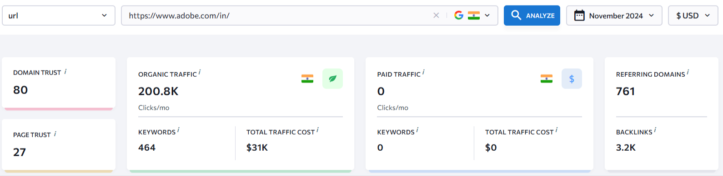
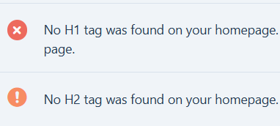
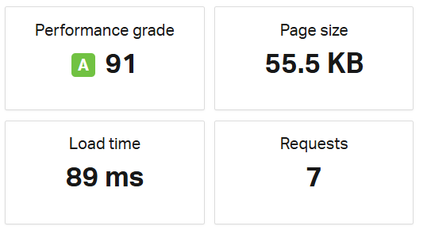
Tools used
SE ranking
RankMath
Ahrefs
Pingdom

Slide 6
Keyword Research
Primary Keywords
PDF editor ( related)
Photo Editor
Remove Background
Video editing software
Photo editing software
Creative cloud
Secondary Keywords
Graphic Design Software
Digital Illustration Tools
Vector Graphics Software
all-in-one creative tool
Long-Tail Keywords
Best photo editing software for beginners
Free video editing software for mac
How to design a website for beginners
Graphic design tools for students
Best video editing software for youtube
Competitor Analysis for Keywords
For Creative Cloud - The competitor rate is very high compared to other service provided by the Adobe.
Adobe's main competitors in keyword research include Canva for online design, Corel for vector and photo editing, Figma for UI/UX tools, Procreate for digital illustration

Slide 7
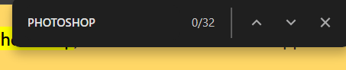
On-Page SEO Optimization Audit
Selected page : https://www.adobe.com/in/products/photoshop.html
Keyword : Photoshop
Effective use of the keyword “Photoshop” in Title Tags , Meta Description and HTML tags
Keyword Usage: photoshop 32 times (keyword Stuffing)
Adobe Logos and their official images have ALT text, but the other images don’t have the ALT description
Internal Linking for pricing, the feature and product viewing –21links
External Linking – 0

Slide 8
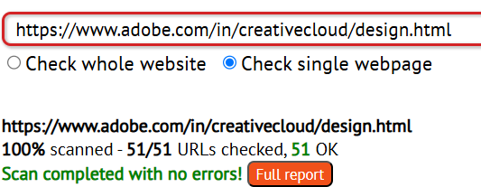
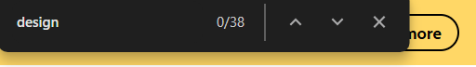
On-Page SEO Optimization Audit
Selected page : https://www.adobe.com/in/creativecloud/design.html
Keyword : design
Effective use of the keyword “Design” in Title Tags , Meta Description and HTML tags
Keyword Usage: Design 33 times (keyword Stuffing)
Adobe Logos and their official images have ALT text, but the other images don’t have the ALT description
Internal Linking are provided for different feature in design - 51 on the page excluding the bottom navigation
No external links
Recommendations : Include External Linking and reduce Keyword Stuffing

Slide 9
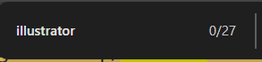
On-Page SEO Optimization Audit
Selected page : https://www.adobe.com/in/products/illustrator.html
Keyword : Photoshop
Effective use of the keyword “Illustrator” in Title Tags , Meta Description and HTML tags
Keyword Usage: Illustrator 27 times (keyword Stuffing)
Adobe Logos and their official images have ALT text, but the other images don’t have the ALT description
Internal Linking for pricing, the feature and product viewing – 19
External Linking – 0
Recommendations : Include External Linking and reduce Keyword Stuffing

Slide 10
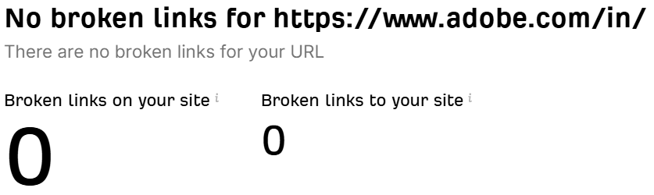
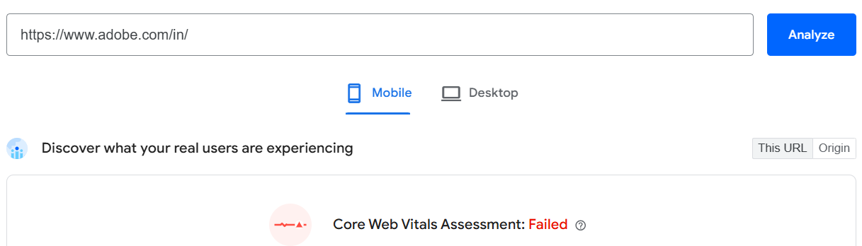
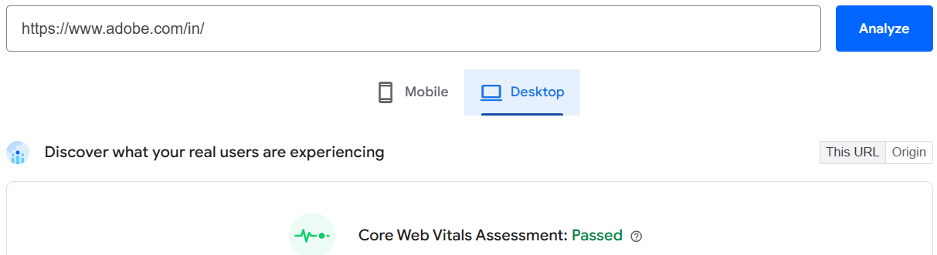
Technical SEO
Home page : https://www.adobe.com/in/
Issues and best practices
Reduce unused JavaScript
Responsive to User: Interaction to Next Paint (INP) is 151ms ; A good responsive webpage should have <=200ms
Largest Contentful Paint (LCP): Largest content element load time is at 3.5s , which is high , it should respond within 2.5s orelse it needs improvement.
No broken Links in the webpage
Use of HTTPS allows user to connect with website
Without any security concerns

Slide 11
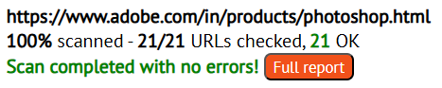
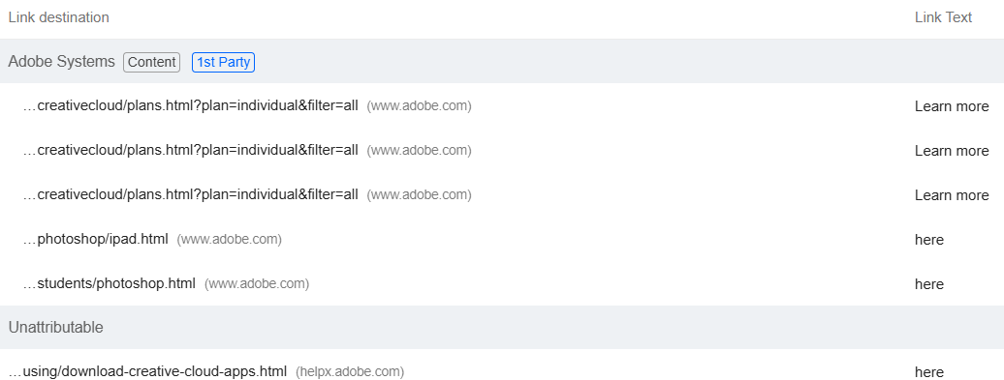
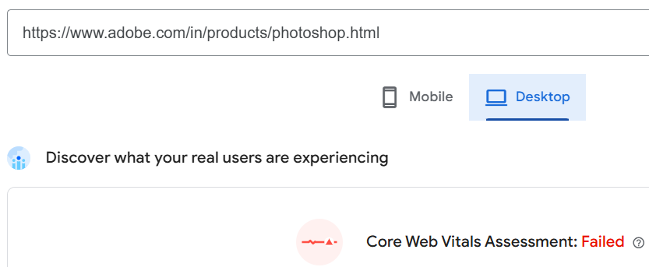
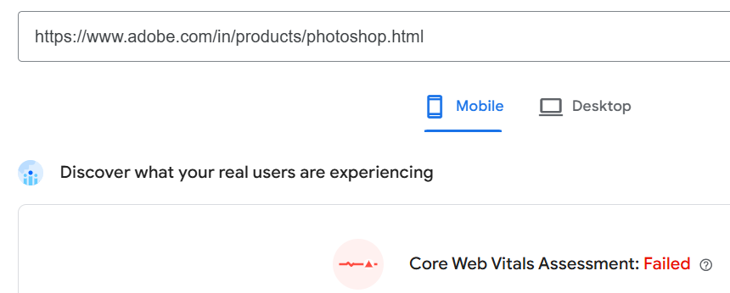
Technical SEO
Home page : https://www.adobe.com/in/products/photoshop.html
Issues and best practices
Largest Contentful Paint (LCP): 3.6s mobile and 3.2s webpage , should be <=2.5s
First Contentful Paint (FCP) : 3.6 s mobile and 3s on webpage , should be <= 1.8s
Minify Javascript to reduce file size
Reduce unused JavaScript and CSS
Improve load time with optimizing image size for mobile browsing
Links doesn’t have descriptive text

Slide 12
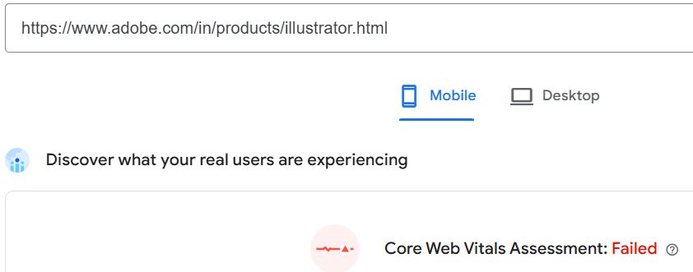
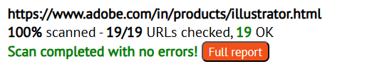
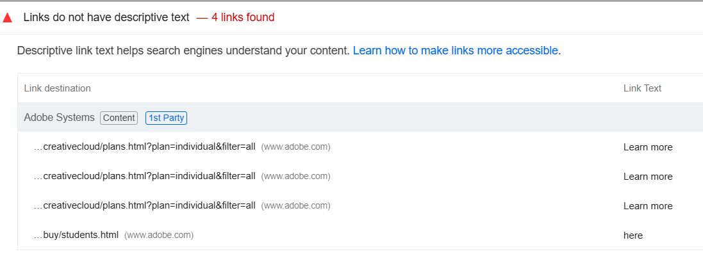
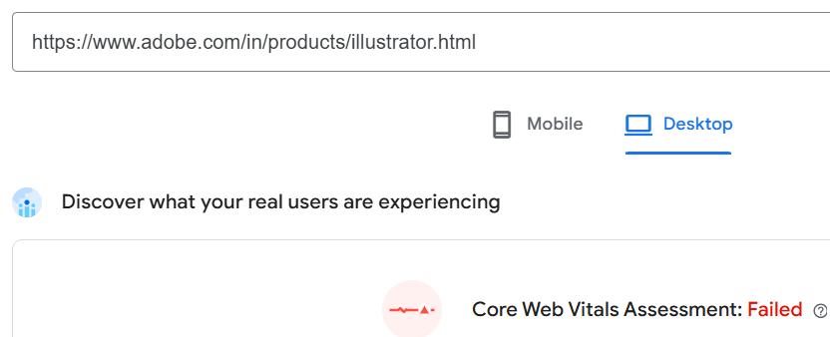
Technical SEO
Webpage : https://www.adobe.com/in/products/illustrator.html
Issues and best practices
Largest Contentful Paint (LCP): 3.8s mobile and 3s webpage , should be <=2.5s
First Contentful Paint (FCP) : 3.5 s mobile and 3s on webpage , should be <= 1.8s
Reduce unused JavaScript and CSS
Improve load time with optimizing image size for mobile browsing
Links doesn’t have descriptive text

Slide 13
Content Strategy
Adobe creative cloud is vastly used in India, collaborate with top artists
Regular events and competitions ( helps with back linking )
Tutorial videos on the website environment and how to use the applications effectively , This attracts new users
Live interaction classes with artists to promote the products.
Blogs on different websites:
Image Editing Mastery: A Comprehensive Guide to Adobe Photoshop
Unleash Your Creativity: Exploring Photoshop's Powerful Tools for Digital Art
From Beginner to Pro: A Step-by-Step Photoshop Tutorial Series
Social media promotions of the adobe products through influencers

Slide 14
Off-Page SEO
Backlink Building: Adobe courses , Youtube tutorials, Third party company and mentions about Adobe softwares by content creators
Blogs and reviews : Blog mentions like comparing applications, tutorial blogs , environment of applications, honorary mentions after getting recognition of the work
High engagement and shares on social media platforms: Adobe encourages content creators by events and also collaborating with the content creators in social media and during their software upgradation
Improvements
Local SEO keyword : optimize the page for local search by including relevant keywords like "Creative Cloud India," "Best design software for India," etc.

Slide 15
Outcomes of this Project
This SEO audit report helped me to learn the required SEO audit tools
Keyword knowledge
Importance of high quality backlinks
Practices to follow for SEO analyst

